Slide 1

AirSential
Advanced Smart Device for Air Quality Monitoring, Gas Leak Detection, and Emergency Response
–- Safeguarding Respiratory Health with Intelligent Hazard Prevention
Sagarika Srivastava
e-mail : sagarikasrivastava46@gmail.com
LinkedIn : issrivastava46
GitHub : issrivastava

Slide 2

WHY ?
The severity of air pollution refers to the level of harmful pollutants in the air and its impact on health, the environment, and daily activities. It is typically measured using the Air Quality Index (AQI), which ranges from 0 to 500.
Low Severity (AQI 0-50): Good air quality, with little to no health risk.
Moderate Severity (AQI 51-100): Some risk for sensitive groups, but generally safe for the population.
High Severity (AQI 101-150): Unhealthy for sensitive groups, such as children and people with respiratory conditions.
Very High to Hazardous Severity (AQI 151+): Health risks for the entire population, with significant environmental damage

Slide 3


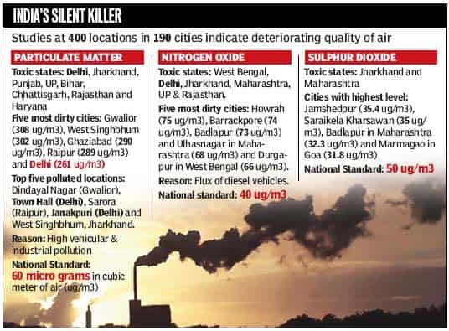
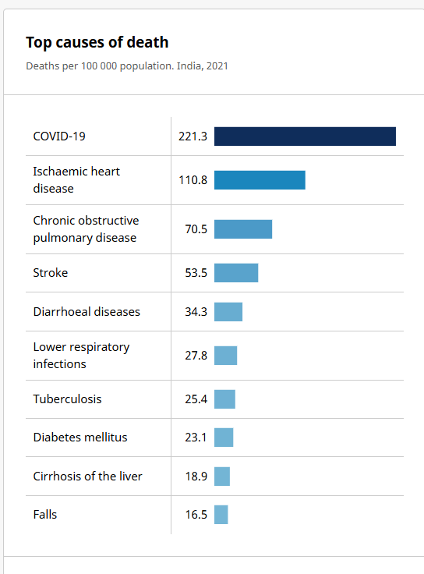

Slide 4

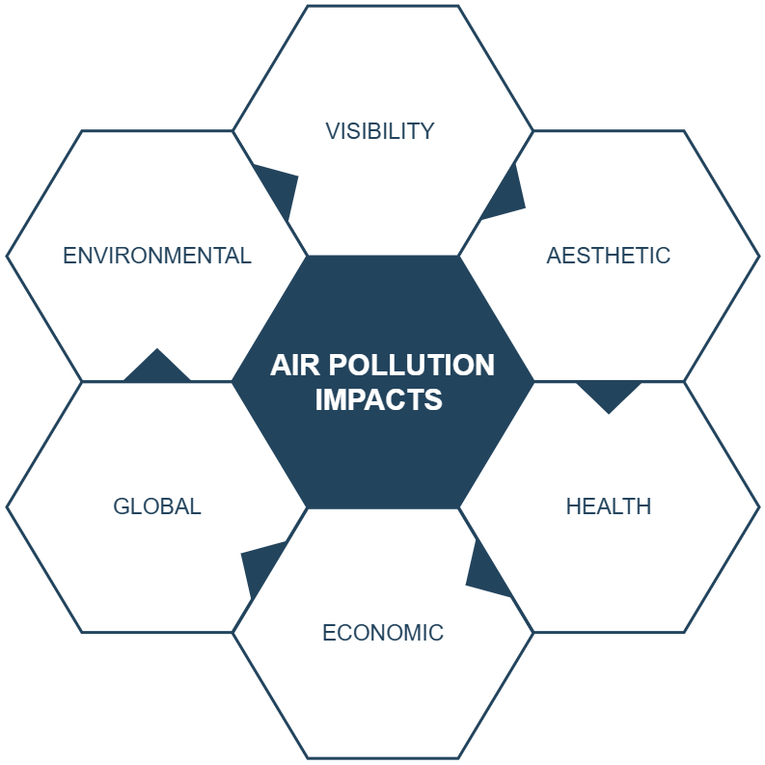
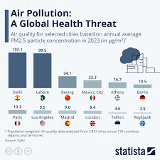
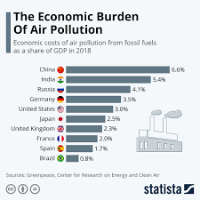

Slide 5
WHAT ?
AirSential is a smart device that monitors air quality, detects gas leaks, and ensures safety through real-time alerts.
Equipped with advanced sensors, it measures pollutants like PM2.5, CO2, and VOCs, while detecting combustible gas leaks. Integrated with a mobile app, it provides instant notifications, personalized recommendations, and smart home compatibility, offering a safer and healthier environment for homes and workplaces.

Slide 6

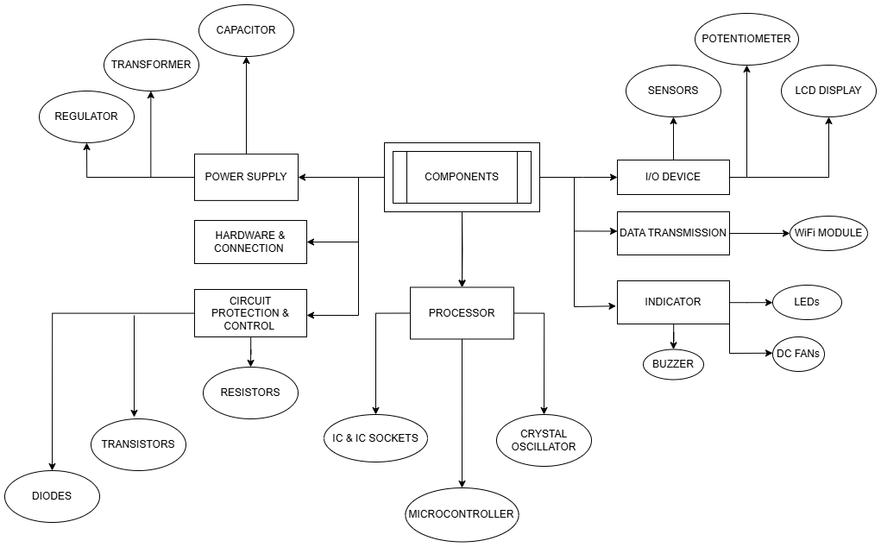

Slide 7
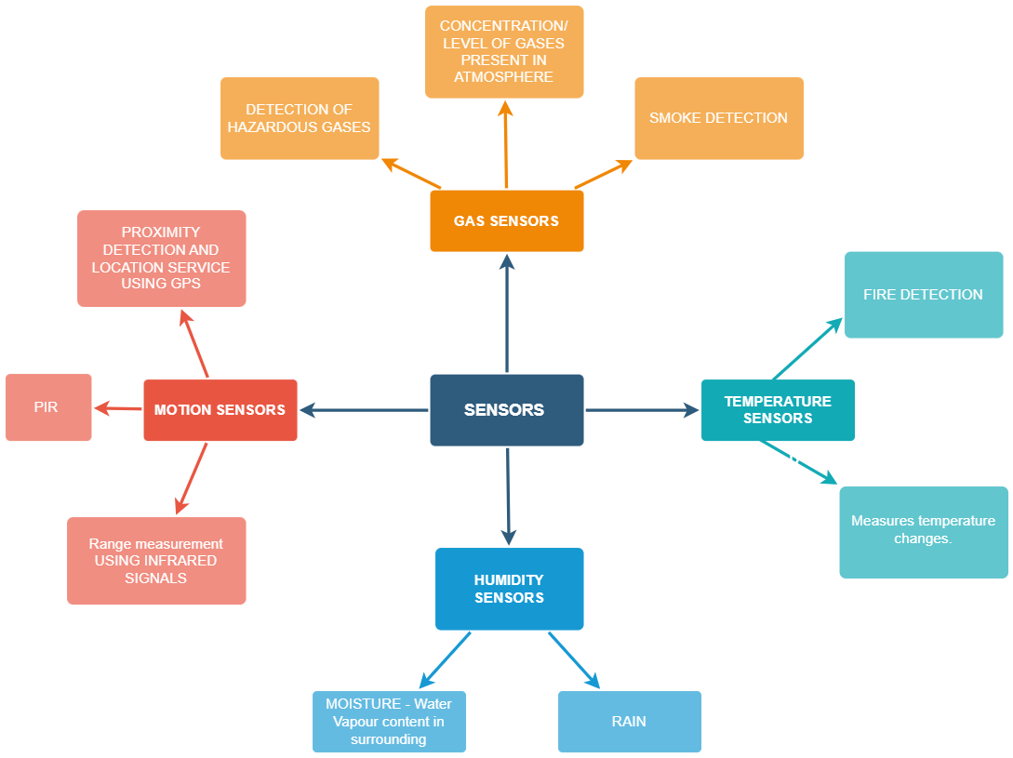

Slide 8

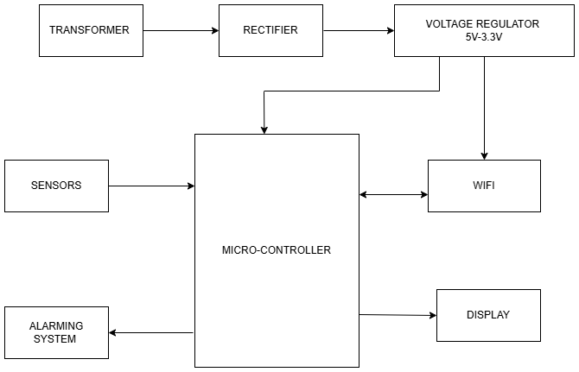

Slide 9

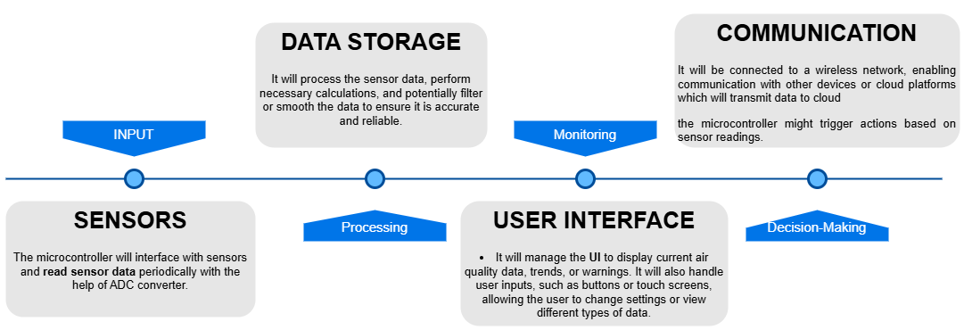

Slide 10
HOW ?
To successfully promote Airsential, a multi-channel approach is essential. The strategy involves leveraging digital marketing through targeted social media campaigns, SEO, and influencer partnerships to build awareness.
Collaborations with smart home companies and healthcare organizations can broaden the product’s reach, while live demonstrations and webinars help engage and educate potential customers on the device's benefits.
Encouraging customer testimonials and offering discounts or referral programs will drive adoption and enhance trust.

Slide 11
PROMOTION STRATEGY
Targeted Digital Marketing - Social Media Campaigns
SEO & Content Marketing - Influencer Marketing Create awareness and drive traffic to product website.
Partnerships & Collaborations - Work with Healthcare Organizations and NGOs Expand reach and build credibility through trusted partners.
Product Demonstrations & Webinars - Organize educational webinars on air quality and gas safety Engage customers and showcase product features.
Customer Testimonials & Reviews - Collect and share user testimonials, Showcase positive reviews and case studies Build trust and social proof.
Discounts & Promotions - Launch limited-time discounts or bundle offers, Implement a referral program Encourage early adoption and word-of-mouth marketing.

Slide 12
Key Partners | Activities | Resources | Value Propositions
Sensor suppliers | R&D, product development | AirSential hardware, cloud services | Monitor air quality and gas leaks
Cloud providers | Marketing & sales | Sensors, IoT devices | Real-time alerts and emergency response
Manufacturers | Customer support | Data infrastructure | Health and safety improvement
Retailers | Regulatory compliance | Development team | Improve air quality in homes, offices, and industries

Slide 13
WHO ?
Airsential is designed for individuals and households concerned about indoor air quality, gas leaks, and respiratory health.
The product is ideal for:
Homeowners
Families
Health-conscious Individuals
Smart Home Enthusiasts
Businesses & Offices
Environmental and Safety Advocates
By targeting these groups, Airsential can provide enhanced air safety and quality, becoming an essential part of daily life for those who prioritize health and environmental well-being.

Slide 14
Customer Segment | Needs & Pain Points | Motivation for Buying | How AirSential Can Help
Homeowners | Concerns about indoor air quality (e.g., allergens, pollutants) | Health and safety of family members, asthma or allergy management | Monitors air quality (PM2.5, CO2, VOCs), alerts for harmful gases
Businesses/Offices | Need to ensure employee safety and comply with health regulations | Compliance with health & safety standards, creating a comfortable work environment | Real-time air quality monitoring, data reports for compliance
Schools/Colleges | Ensuring a safe and healthy environment for students and staff | Compliance with educational health standards, improving air quality | Monitors air quality for classroom and common areas
Healthcare Facilities | Maintaining a high-quality environment for patients (e.g., ICU, labs) | Protecting vulnerable individuals (e.g., asthma patients, elderly) | Monitors air quality, detecting harmful gases for better patient care
Industrial Facilities | Need to monitor workplace hazards like gas leaks or poor air quality | Compliance with workplace safety regulations, preventing accidents | Gas leak detection, air quality monitoring in hazardous areas
Smart Cities | Environmental data collection, improving public health and safety | Monitoring and improving city-wide air quality | Integrates into smart city infrastructure, public health monitoring
Environmental Agencies | Tracking pollution levels for regulatory compliance | Data for environmental impact reports, public awareness | Real-time and historical air quality data, extensive monitoring

Slide 15






Thank You !

